Slide 2

Unit 9: Creating Application Page Controls

Slide 3
Lesson Objectives
After completing this lesson, you should be able to:
List different types of page-level items
Create and use page-level items
Create and use buttons
Notes:
Developers can create and manage a variety of database application page controls, including page-level items, dynamic actions, buttons, and trees. In this lesson, you learn how to create and use page-level items, and buttons.

Slide 4
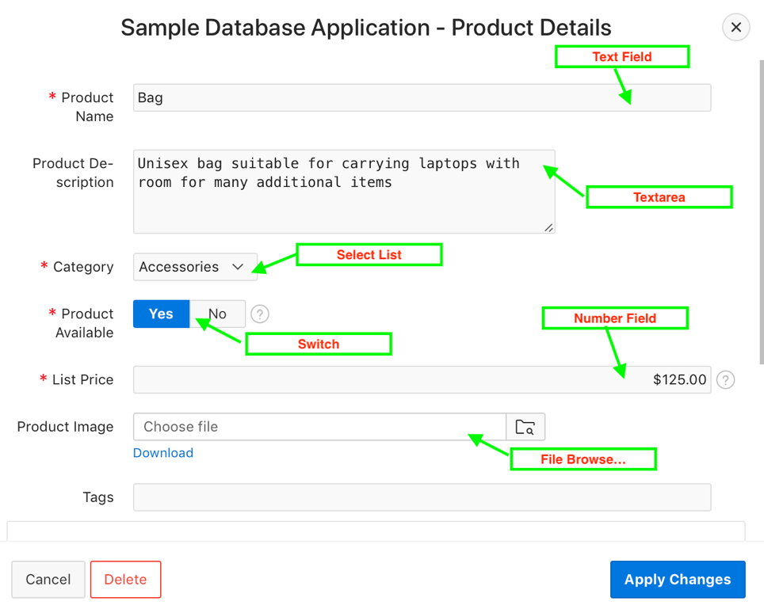
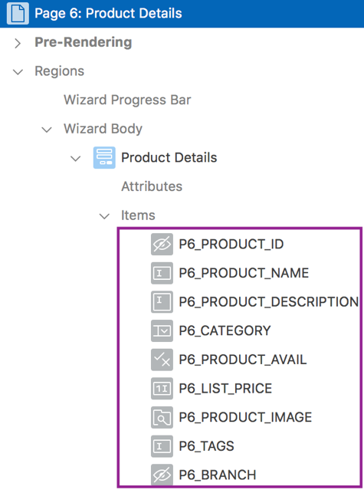
Understanding Items
An item is part of an HTML form. There are two types of items:
Page items
Application items
Page Items: Examples
Viewing page items in Page Designer
Notes:
An item is part of an HTML form. An item can be a text field, text area, password, select list, check box, and so on. Item attributes affect the display of items on a page. For example, these attributes can impact where a label displays, how large an item is, and if the item displays next to or below the previous item.
There are two types of items:
Page items are placed on a page and have associated user interface properties, such as Display Only, Label and Label Template. Examples of page-level items include a check box, date picker, display as text, file browse field, popup list of values, select list, or a text area.
Application items are not associated with a page and therefore have no user interface properties. You can use an application item as a global variable.
The slide shows Product Details form page in Page Designer. You see different items listed under the Items node. The slide also shows a few examples of page items: Text Field, Text Area, Select List, Switch, Number Field, and File Browse… types.

Slide 5
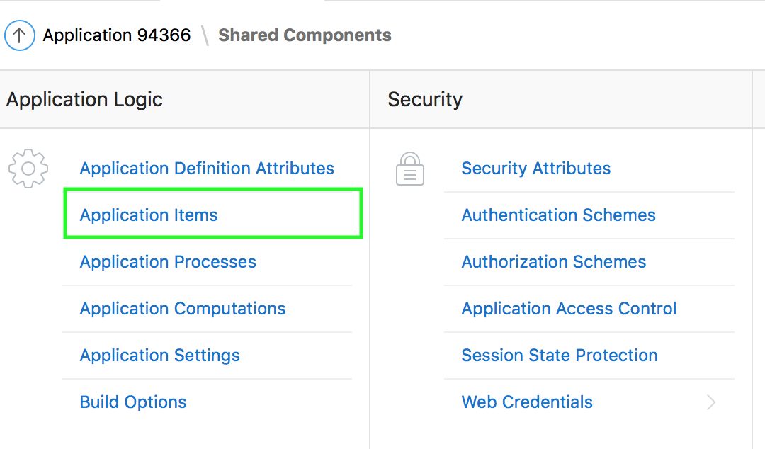
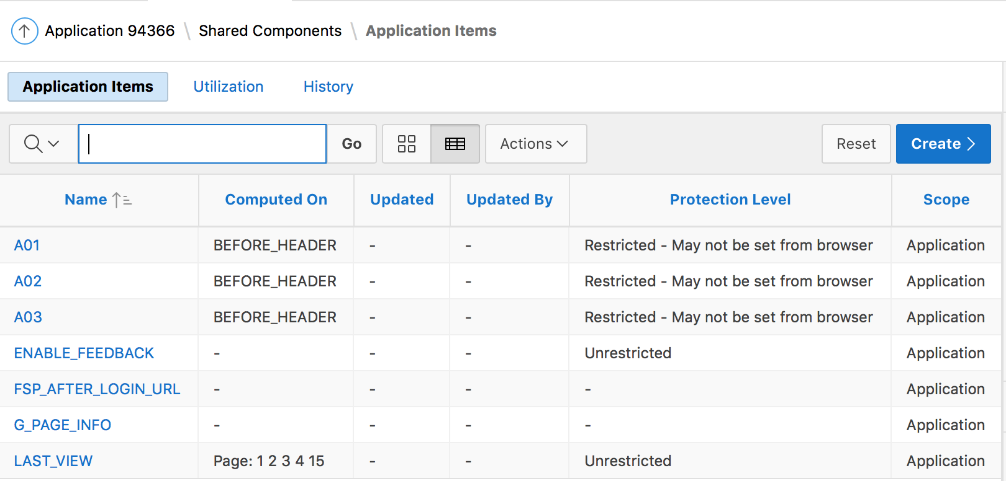
Understanding Application Items
Notes:
Application-level items do not display, but you can use an application item as a global variable to the application. Application items can be set using computations, processes, or by passing values on a URL. You use Application Items to maintain session state that is not displayed and is not specific to any one page.
To access the Application Items page, perform the following steps:
On your application home page, click Shared Components
Under Application Logic, click Application Items. The Application Items page is displayed.

Slide 6
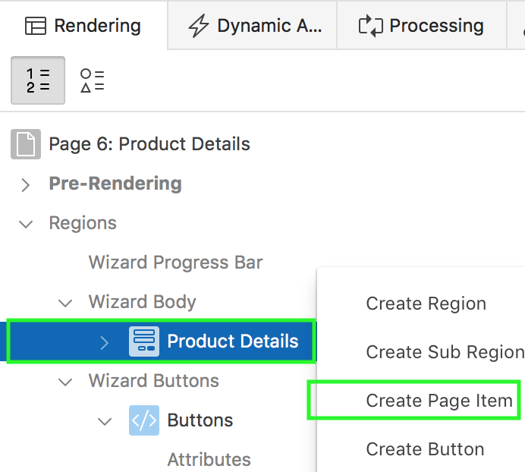
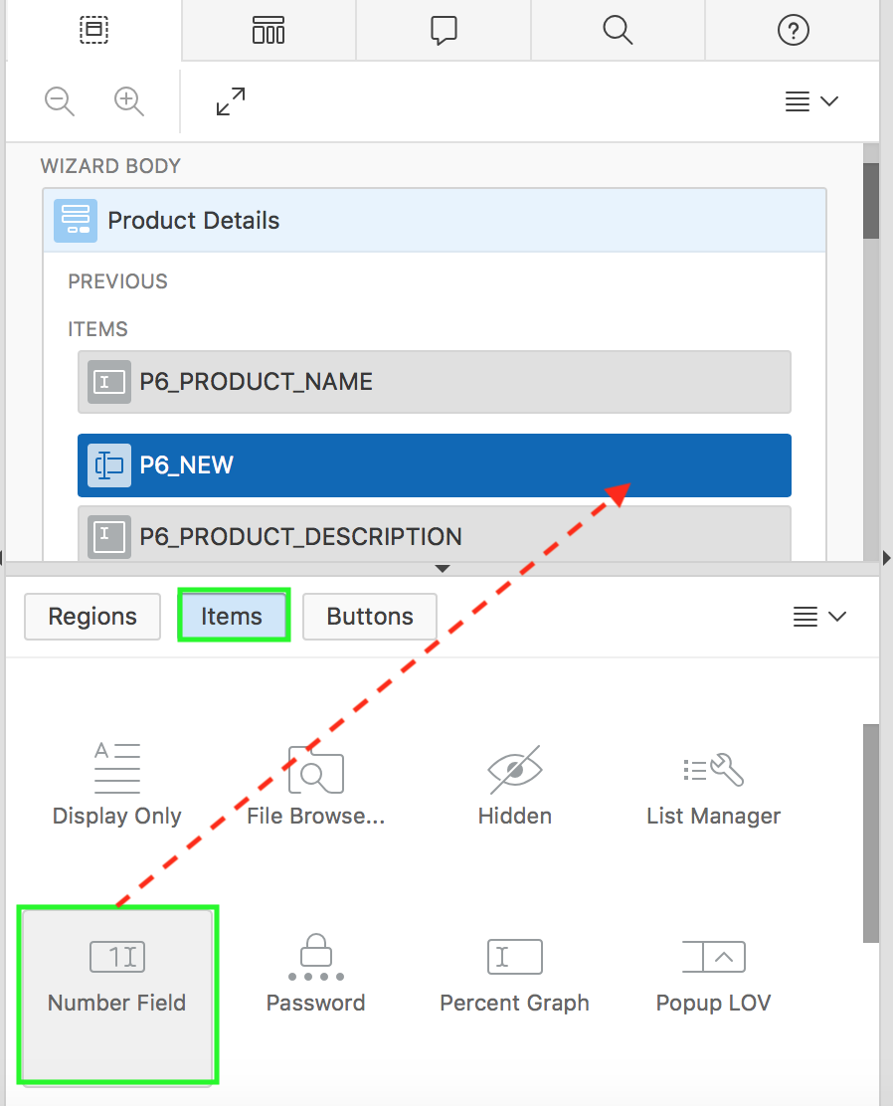
Creating a Page Item
From the Rendering tab
From the Gallery
Drag and Drop
Notes:
You can create a page item in either of the following ways:
From the Rendering tab: Navigate to Page Designer. Under the Rendering tab, right-click the region node where you want to create the item and select Create Page Item.
From the Gallery: Navigate to Page Designer. In the central pane, click Layout and then the Items tab in the Gallery. Passing the cursor over an item displays a tooltip that describes it. Select the item that you want to create and drag it to the appropriate location in the Layout where you want to create the item.
After either of the above steps, the Property Editor displays Page Item attributes. Attributes are organized in groups.The Messages tab displays a red or yellow badge to identify messages you need to address. Selecting a message displays the associated attribute in the Property Editor. You must address red error message before you can save. Edit the appropriate attributes in the Property Editor.
Note: To create an item from the gallery, you can also right-click the item, click Add To, and select the appropriate location.

Slide 7
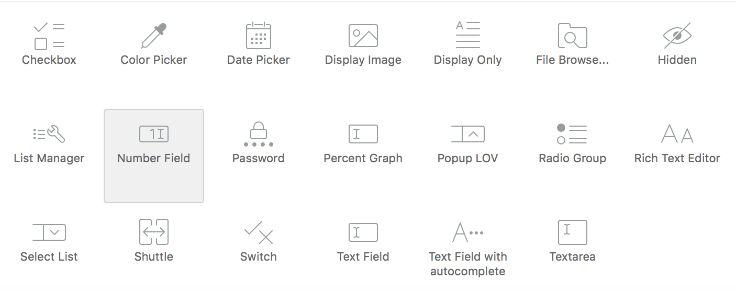
Different Types of Page Items
Notes:
Application Express allows to create the following page item types:
Checkbox: Displays multiple values as check boxes, enabling the end user to select multiple values. A list of values is required for items displayed as check boxes. The values corresponding to the checked boxes are stored in a single colon-delimited string.
Color Picker: Displays a text field with a color picker icon. End users can either enter a HTML color code directly, or click the icon to display a color palette popup. The end user can click a color from the palette which returns the corresponding HTML color code for the selected color.
Date Picker: Displays a text field with a calendar icon. End users can either enter the date directly into the text item, or click on the calendar icon to select a date, and optionally a time, from the calendar popup. Time is only displayed in the calendar popup if the Format Mask for this item includes time components.
Display Image: Displays an image stored in a database BLOB columns, or based on an image URL.
Display Only: Displays a non-enterable text item.
File Browse...: Displays a text field with a Browse... button. The Browse button enables the user to locate and upload a file from a local file system.
Hidden: Items that are included within the page source but are not rendered. Hidden item values are saved in session state. They are generally used to store values required by page processing or other page items, but should not be displayed to the end user.
List Manager: Displays a text item with a popup list of values icon, Add and Remove buttons, and a list of selected values. You can type in the value or pick from the list of available items. You can then utilize the buttons to manage the values selected. The selected values are stored in a single colon-delimited string.
Number Field: Displays a number field. This item type automatically validates that the value is a number.
Password: Displays an HTML password form element. As the end user enters text a black dot is displayed for that character, instead of the actual character entered.
Percent Graph: Displays the value as a percentage graph. The value retrieved must be between 0 and 100.
Popup LOV: Displays a text item with a popup list of values icon. When the end user clicks the icon, a popup window appears with a search field, and a list of supported values. Popup LOV is best suited for large lists since end users can enter search criteria to reduce the available values displayed. For relatively small lists Select List is often better suited.
Radio Group: Displays multiple values as radio group options, enabling the end user to select a single value.
Rich Text Editor: Displays a text area with comprehensive text formatting options. End users can enhance the content displayed in a similar fashion to using a word processor, such as Microsoft Word. End users can also cut and paste documents, that are in rich text format (RTF) file format, into this item.
Select List: Displays an item with a built-in list of values selector. When the end user clicks the item, the list of supported values displays directly inline with the current item. Select List is best suited for relatively small, discrete lists. End-Users can very quickly select a value from the list without needing to change focus to a popup dialog. For large lists Popup LOV is often better suited.
Shuttle: Displays as a multiple select list that includes two boxes containing lists. The left list displays the source list of values that have not been selected and the right list shows the currently selected values. End users can select one or more values in a list then use the shuttle controls to move the selected values or all values. The current values are stored in a single colon-delimited string.
Switch: Displays as a flip toggle switch.
Text Field: Displays a text field.
Text Field with autocomplete: Displays a text field that displays a list of possible values, based on the text already entered by the end user, inline with the text item. The list is further refined as the end user types in more text.
Textarea: Displays a multiple-row text area.
Depending on your application configuration, you may also have additional item type plug-ins available. These display as <My Plug-in> [Plug-in].

Slide 8
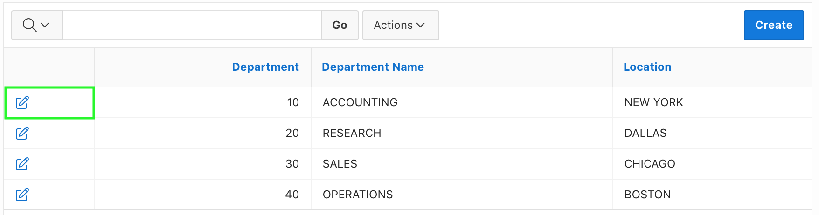
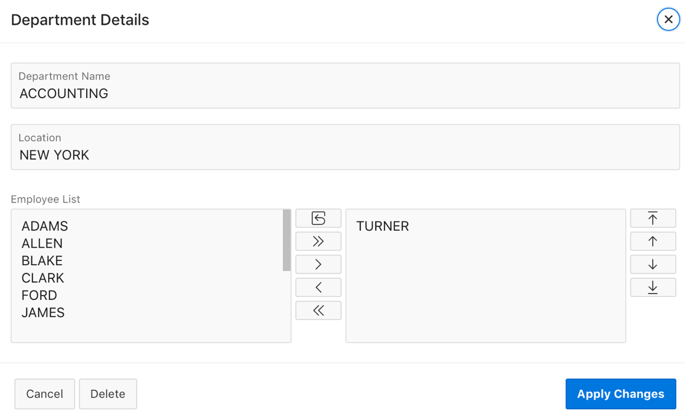
Creating a Page Item: Example
Shuttle item type
Notes:
The slide shows an example of a shuttle item type created on the Department Details form page. In this example, you first create a report with form on the DEPT table that shows which employees are assigned to a given department. Second, you create a shuttle item that lists employees alphabetically to make it easier to assign employees to a department.

Slide 9
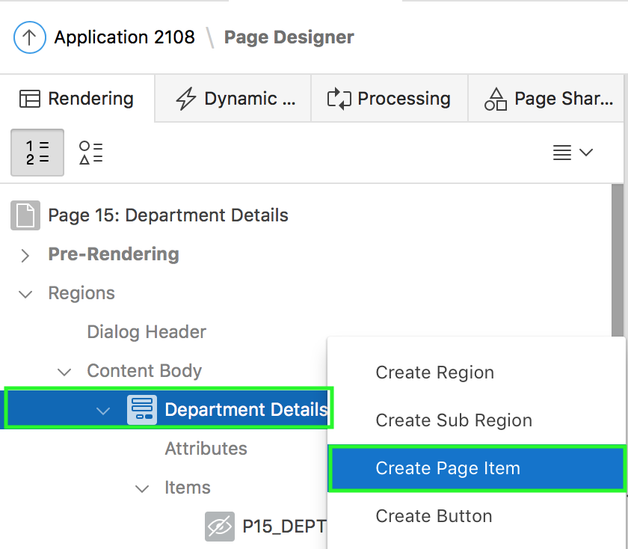
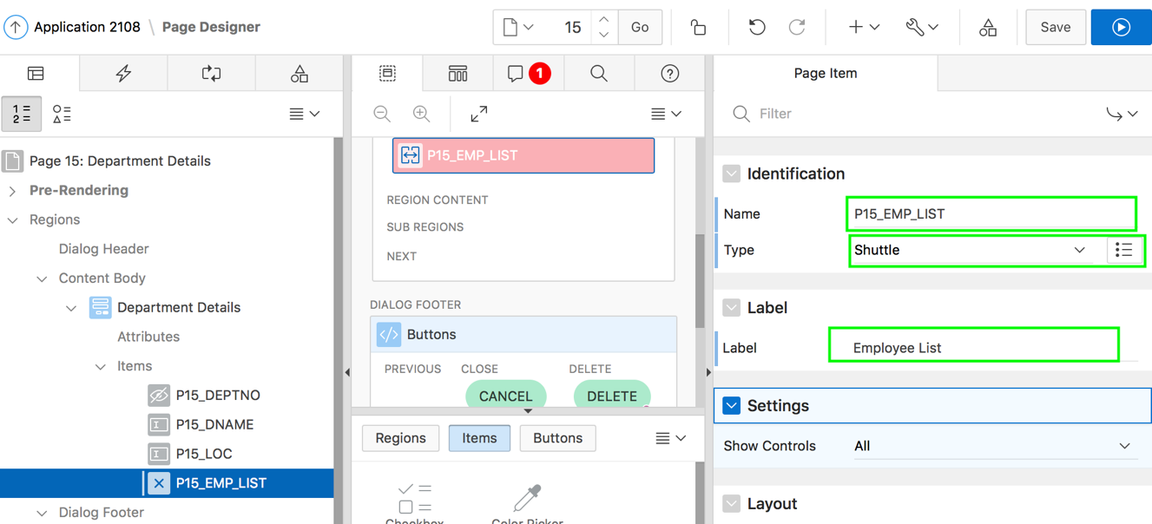
Creating a Page Item: Example - Steps
1
2
Notes:
The slide shows steps to create a shuttle item type on the Department Details form page. In step 4, the example also shows how to set the item value.
For page items, you use the Source attribute to set the item value. From the page, select the item name to view the Edit Page Item page. Scroll down to Source and edit the appropriate fields.
As explained in the previous slide, you already created a report and form on the DEPT table. For example, Page 14: Departments Report and Page 15: Department Details form. The form is created as a dialog page.
Perform the following steps to create a shuttle item type:
View the form in Page Designer. In Page Rendering, right-click the region containing the form (for example, Department Details in the slide) and select Create Page Item.
Next, enter attributes in Property Editor - Page Item. For Identification > Name, enter PX_EMP_LIST. For Type, select Shuttle. Notice the error message in the central pane that says List of Values type is required. In the slide, you replace the existing name for Label with Employee List. You learn about LOVs (List of Values) later in this lesson.

Slide 10
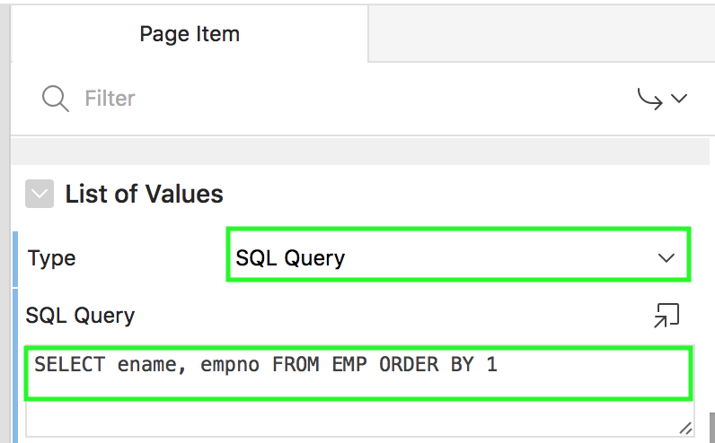
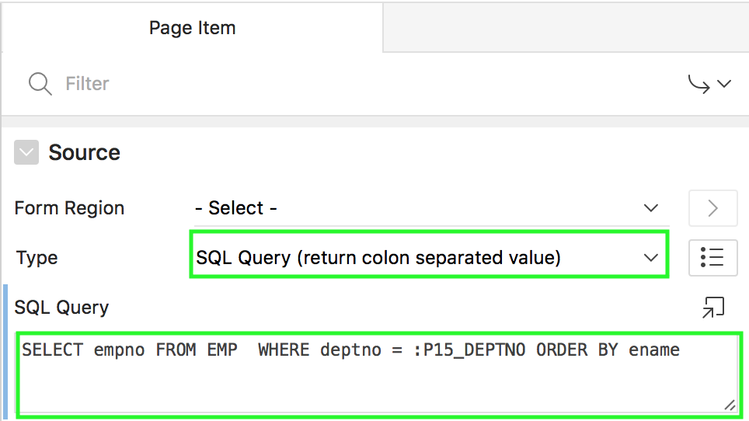
Creating a Page Item: Example - Steps
3
4
Notes:
Under List of Values, select SQL Query for Type. For SQL Statement, enter SELECT ename, empno FROM EMP ORDER BY 1
Under Source, for Type, select SQL Query (return colon separated value). For SQL Query, enter SELECT empno FROM EMP WHERE deptno = :P15_DEPTNO ORDER BY ename Now, click Save. You can click Save and Run Page now to see how the shuttle item type appears on the form page. However, if you created the form as a dialog page, you need to first run the report page and then click a record to view the form page.
Note: You can reference item values stored in session state in regions, computations, processes, validation, and branches. For more information, see Oracle Application Express App Builder User’s Guide

Slide 11
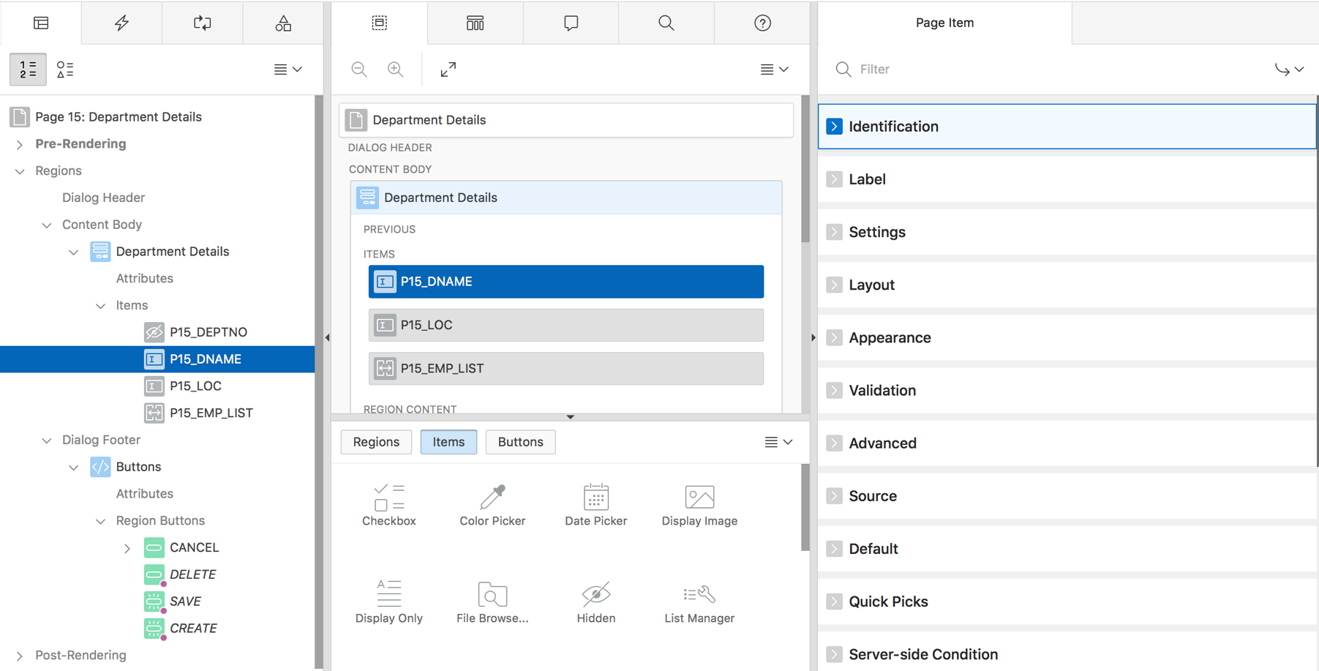
Editing a Page Item
Notes:
Item attributes affect the display of items on a page. For example, these attributes can impact where a label displays, how large an item is, and if the item displays next to or below the previous item.
To edit item attributes in the property editor, perform the following steps:
View the page in Page Designer
In either the Rendering tab or the Layout tab, select the item to edit. The Property Editor changes to display item attributes. Attributes are organized in groups.
To find a group or attribute:
Search for the group or attribute - Enter keywords in the Filter Properties field. The Property Editor displays the group or attributes. To return to the default display, delete the keywords.
Use Go to Group - Click Go to Group and select the group. To return the default display, click Go to Group again and select Expand All.
Edit the appropriate attributes. Edited attributes display a blue marker to the left of the attribute name until the page is saved. Note: To learn more about an attribute, see field-level Help.
Click Save.

Slide 12
Referencing Item Values
You can reference item values stored in session state in regions, computations, processes, validation, and branches
Syntax for referencing item values:
Type
Syntax
SQL
:MY_ITEM
PL/SQL
V('MY_ITEM')
PL/SQL
NV('MY_NUMERIC_ITEM')
Static Text (exact)
&MY_ITEM.
Notes:
Syntax for referencing item values:
:MY_ITEM – Use this syntax for references within a SQL query and within PL/SQL code.
V('MY_ITEM') – This is the PL/SQL syntax referencing the item value using the V function. Use this syntax in PL/SQL code of packages or stored procedures and functions. Avoid this syntax in SQL statements. It may result in performance problems.
NV('MY_NUMERIC_ITEM') – This is the standard PL/SQL syntax referencing the numeric item value using the NV function. Use this syntax in PL/SQL code of packages or stored procedures and functions. Avoid this syntax in SQL statements. It may result in performance problems.
&MY_ITEM. - Static text. Exact Substitution. Exact substitution syntax should be avoided in SQL or PL/SQL code because it can result in SQL Injection vulnerabilities.

Slide 13
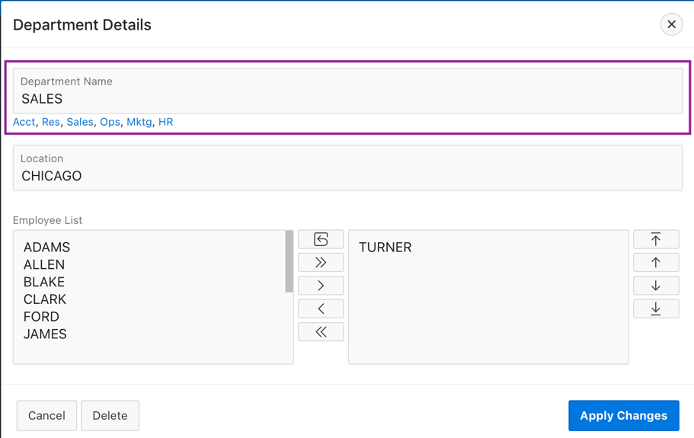
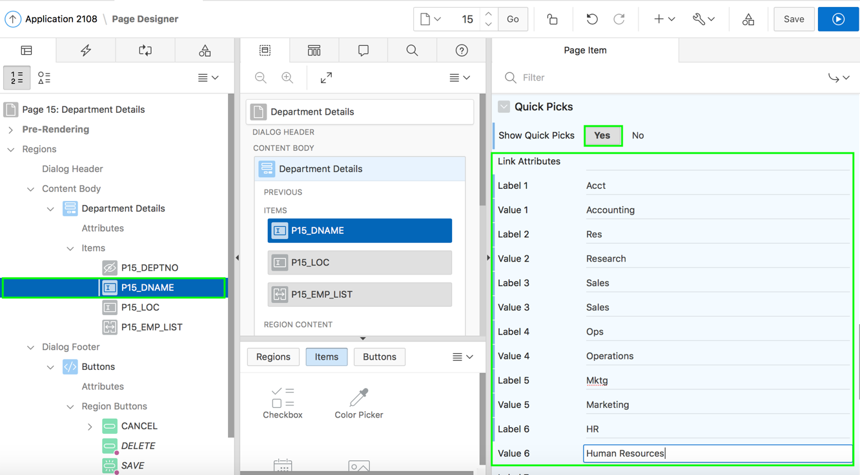
Creating a Quick Pick Selection
Quick pick to select department name
Steps to create a quick pick
Notes:
Quick picks enable users to select predefined values with just one click, rather than typing in text or selecting from a list of available options. If the item type supports quick pick selection, use the Quick Picks attributes to define up to ten selections that display under a given item. Clicking on a quick pick sets the value of item.
The slide shows an example of creating quick picks to select a department name on the Department Details form.
To create a quick pick in page designer, perform the following steps:
View the item attributes in the Property Editor. In the slide, select P<n>_DNAME and view the item attributes in the Property Editor.
Under Quick Picks, specify whether quick picks display for this page item.
Show Quick Picks: Select Yes
Link Attributes: Enter HTML attributes that are associated with the display of each Quick Pick link
Label X: Enter the label for the each Quick Pick. This label is the text the end user of the application sees. In the slide, for example, you enter Acct for Label 1.
Value X: Enter the value associated with each Quick Pick. This value replaces the existing item value when the user clicks the quick pick. In the slide, for example, you enter Accounting for Value 1.
Click Save.

Slide 14
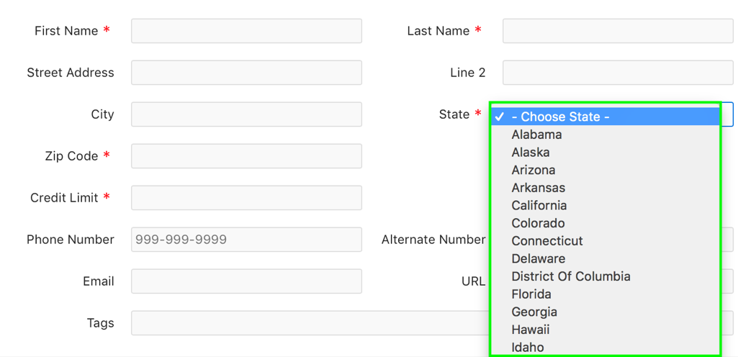
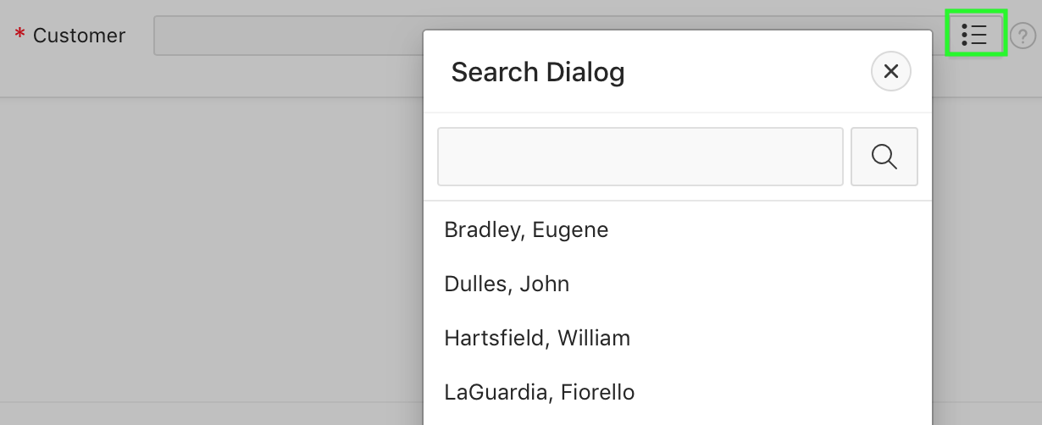
What is a List of Values (LOV)?
Popup LOV
Select List
Notes:
A list of values (LOV) is a static or dynamic set of values used to display a specific type of page item, such as popup lists of values, a select list, a check box, a radio group, or multiple select lists. By creating a list of values at the application-level, you are creating a shared component. Creating a LOV as a shared component (also known as named LOV) has the following advantages:
You can add it to any page within an application.
All LOV definitions are stored in one location, making them easy to locate and update.
A list of values can be referenced by page items as well as report fields. It controls the values displayed and limits the user's selection.
You define named (or shared) LOVs at the application level by running the Create LOV Wizard and adding them to the List of Values repository. Lists of Values can be static or dynamic:
Static lists are based on predefined pairs of display values and return values
Dynamic lists are based on a SQL query you write that selects values from a table

Slide 15
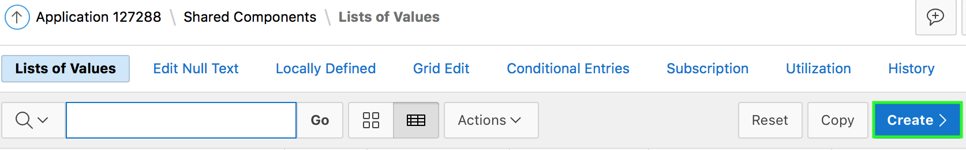
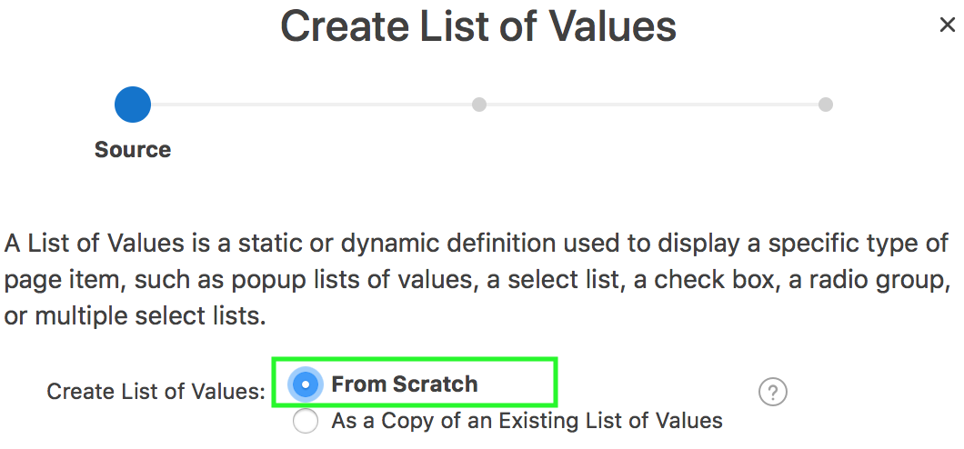
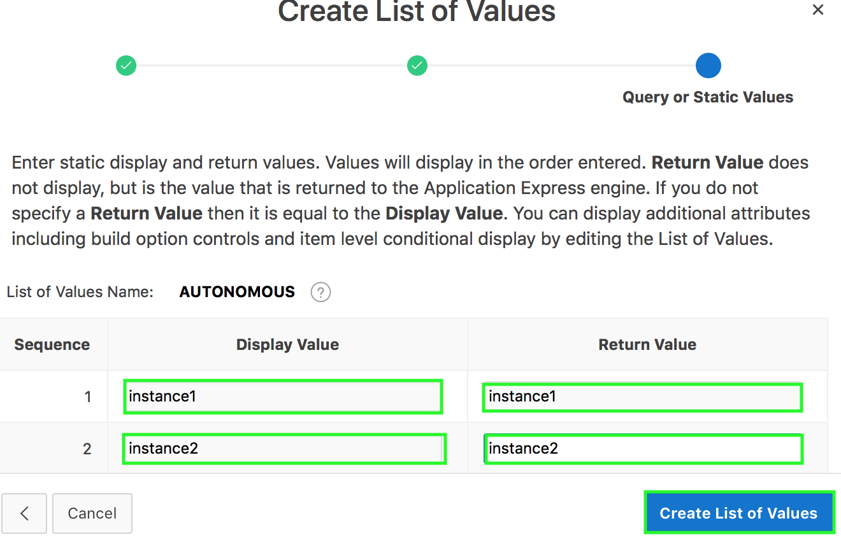
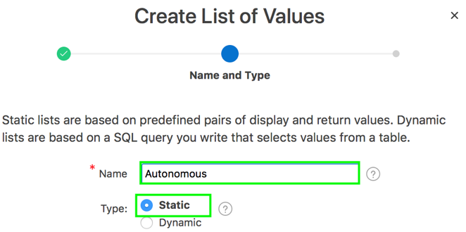
Creating a Static LOV
1
2
4
3
Notes:
Static LOVs are based on a static list of display values and return values you specify when you run the Create LOV Wizard. To create a static LOV, run the Create LOV Wizard and select the LOV type Static. Oracle Application Express stores the display values, return values, and sort sequence you specify in the List of Values repository. Once you add a static LOV to the repository, you can create an item and display it as a check box, radio group, select list, or popup list based on this definition.
To create a static LOV, perform the following steps:
Navigate to your application home page and click Shared Components > Other Components and select List of Values. The Lists of Values page appears. Click Create.
Select from Scratch and click Next.
Specify a name for the LOV. Select Static and click Next.
Now, enter static display and return values. Values will display in the order entered. Return Value does not display, but is the value that is returned to the Application Express engine. If you do not specify a Return Value then it is equal to the Display Value. Click Create List of Values.

Slide 16
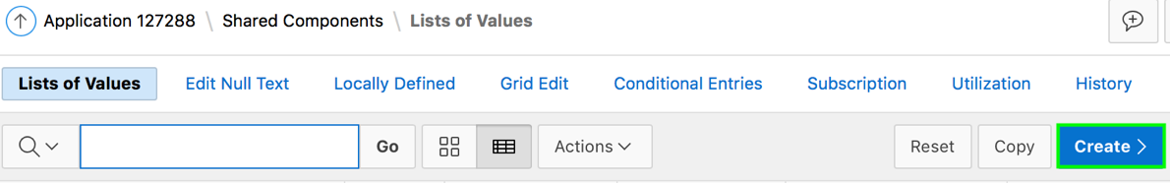
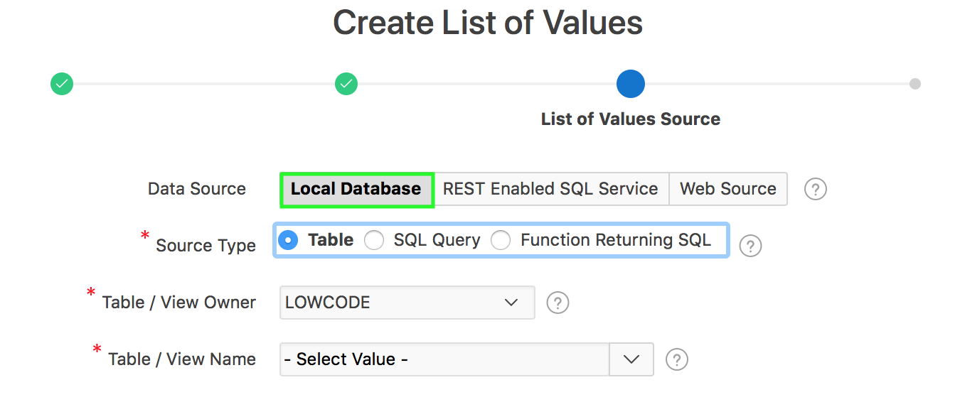
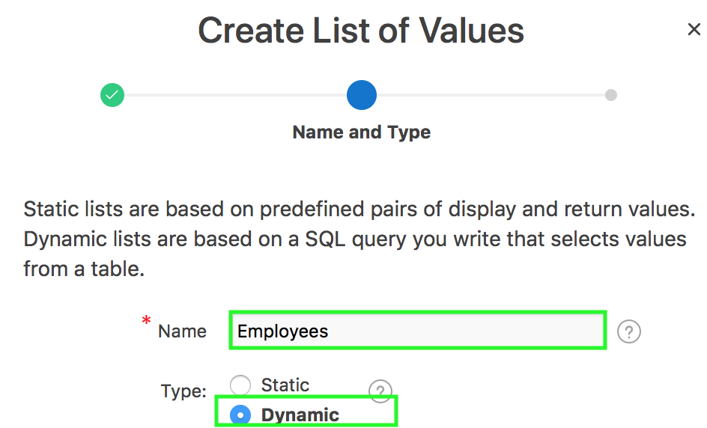
Creating a Dynamic LOV
2
1
4
3
Notes:
To create a dynamic LOV, perform the following steps:
Navigate to your application home page and click Shared Components > Other Components and select List of Values. The Lists of Values page appears. Click Create.
Select from Scratch and click Next.
Specify a name for the LOV. Select Dynamic and click Next.
The default data source is Local Database. You can also select REST Enabled SQL Service or Web Source. In the slide example, you accept the default data source, Local Database. Click Next.

Slide 17
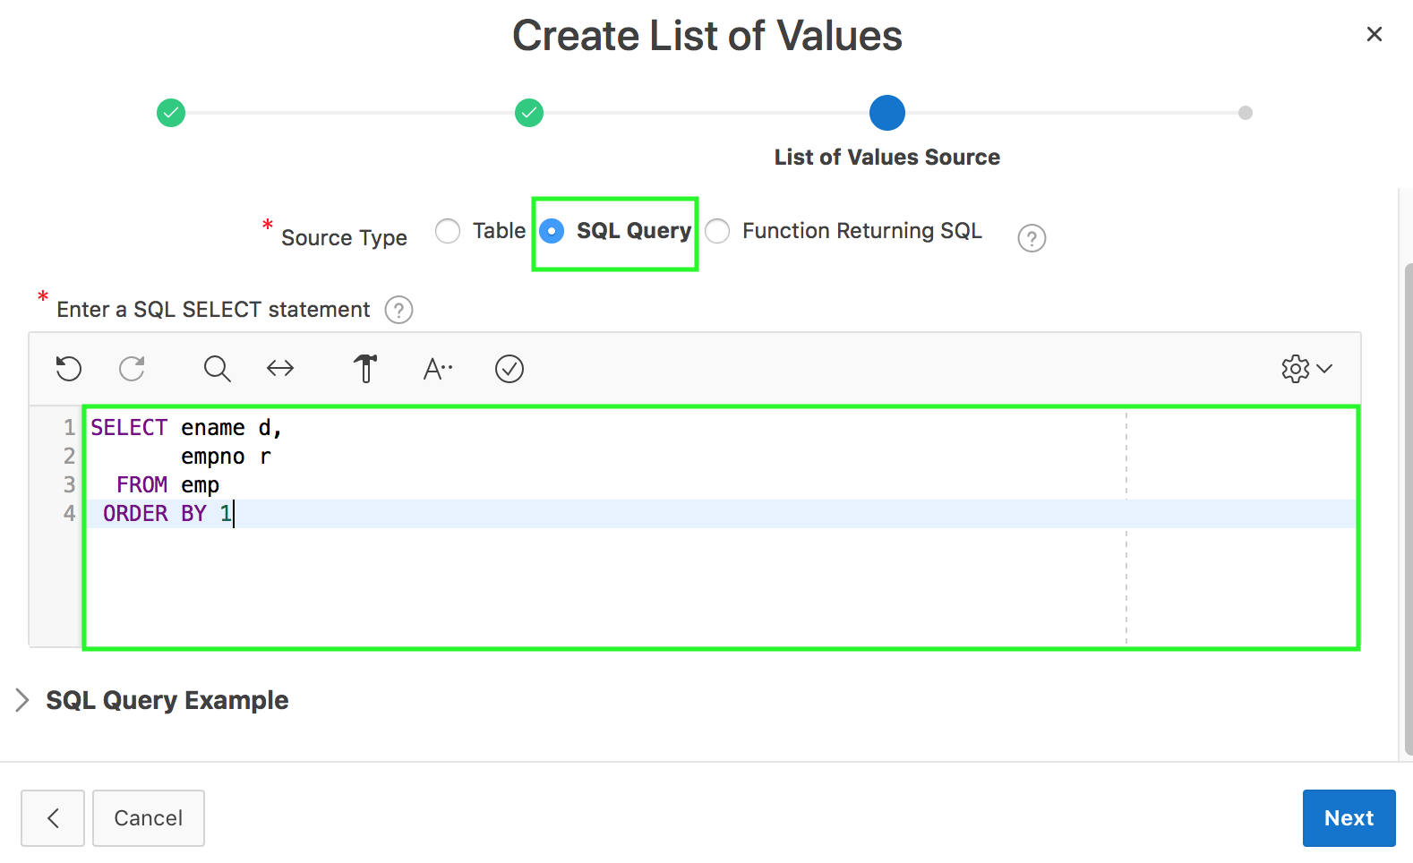
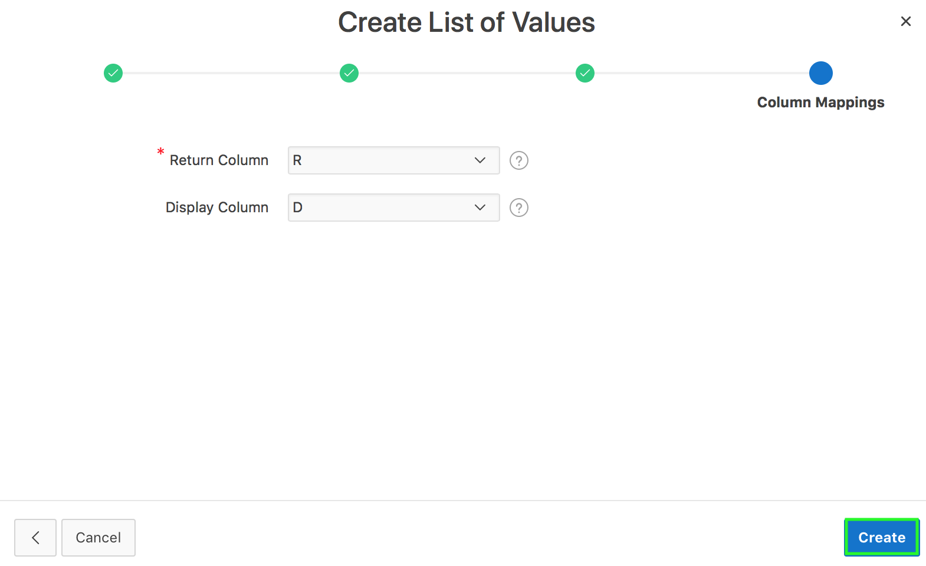
Creating a Dynamic LOV
5
6
Notes:
Select a source type. In the slide example, you select SQL Query. Now, enter a SQL query that returns two columns. The first column is the display value. The display value is the value you see in a list of values. This column should be aliased and a different name than the return column. The second column is the return value. The return value is the value returned when the display value is selected. The return column should be aliased if it includes any operations. Use bind variable syntax within your SQL query to reference the session state of the application or page items. Click Next.
For Column Mappings, specify the return column and display column. Click Create List of Values.

Slide 18
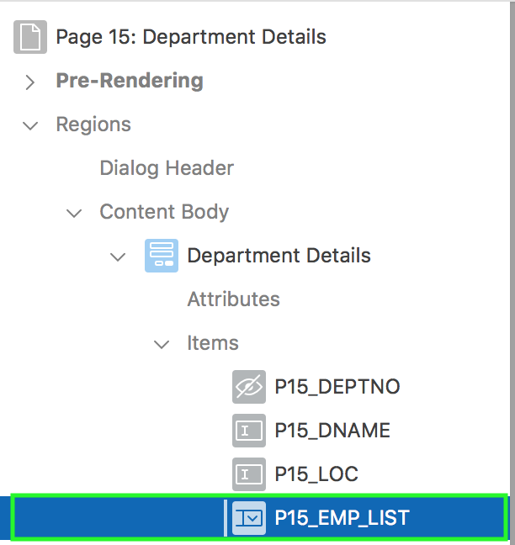
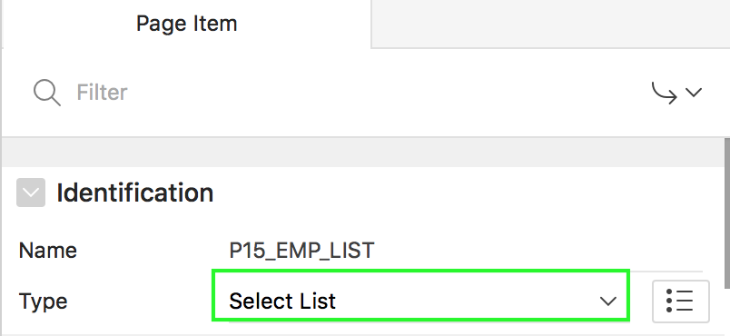
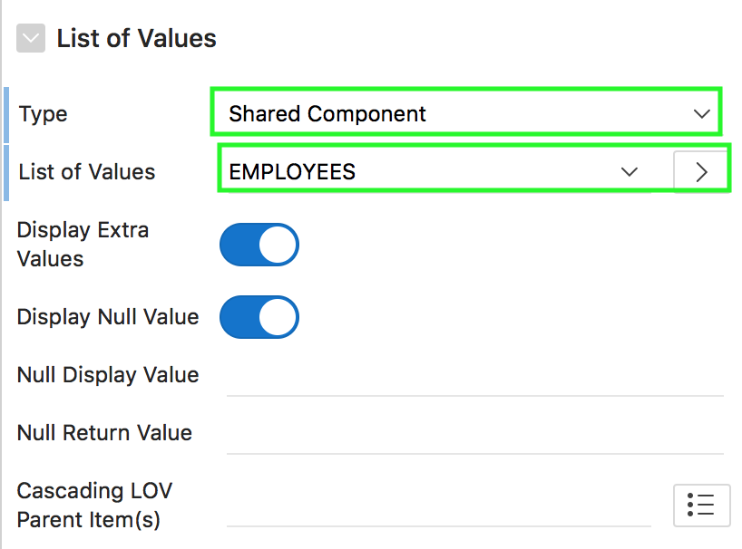
Associating a Named LOV with an Item
2
1
3
Notes:
After creating a named LOV (shared component), you can associate it with a page item type that can accept list of values, for example, Select List, Shuttle, Checkbox, Radio Group, Popup LOV, and List Manager. The slide example shows associating the employees dynamic LOV with the P<n>_EMP_LIST page item. Perform the following steps:
View the page in Page Designer. Under Rendering, expand Items and select the item with which you want to associate the LOV.
The page item display type should be an LOV type. For example, in the slide, the display type is Select List.
In the Property Editor, under List of Values, select Shared Component for Type. Then, select the named LOV from the List of Values select list. In the slide, you select EMPLOYEES. Now, click Save.

Slide 19
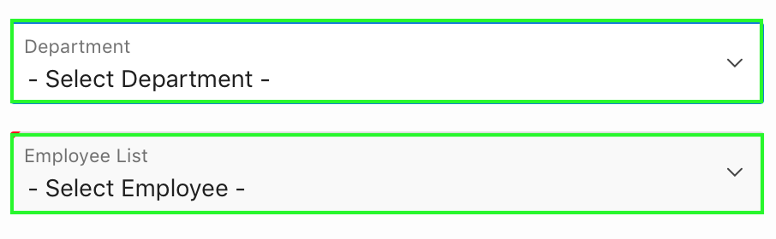
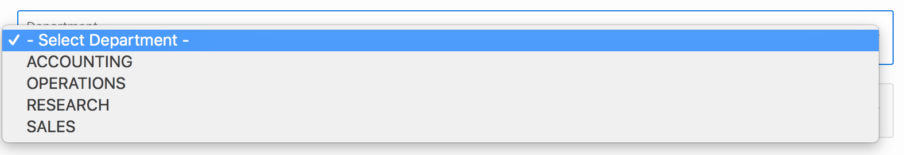
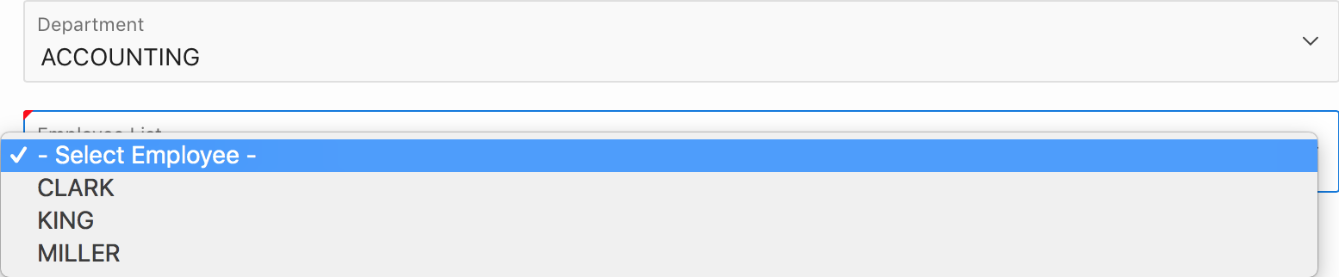
Creating a Cascading LOV
Two related select lists where the value of the first list populates the second.
Notes:
In the slide example, two select lists appear. Making a selection in the Department select list, determines which individuals display in the Employees select list.
By creating a cascading list of values (LOV), one item on a page determines the list of values for another item. App Builder includes cascading LOV support for the item types: Select List, Shuttle, Checkbox, Radio Group, Popup LOV, and List Manager.
You create a cascading LOV by creating two items. To populate the second item, you specify a Cascading LOV Parent Item when running the Create Item Wizard or by editing the item's attributes.

Slide 20
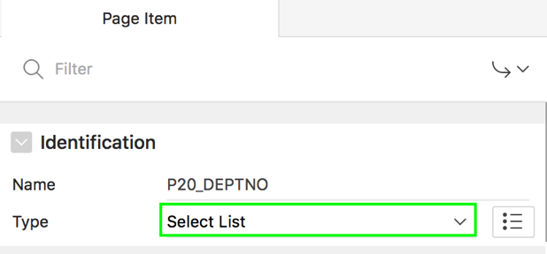
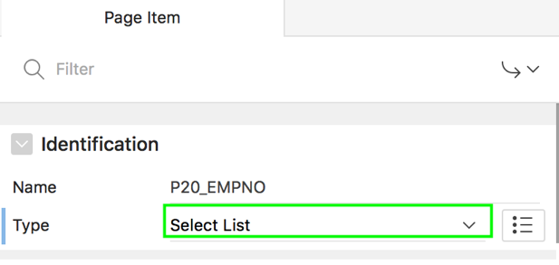
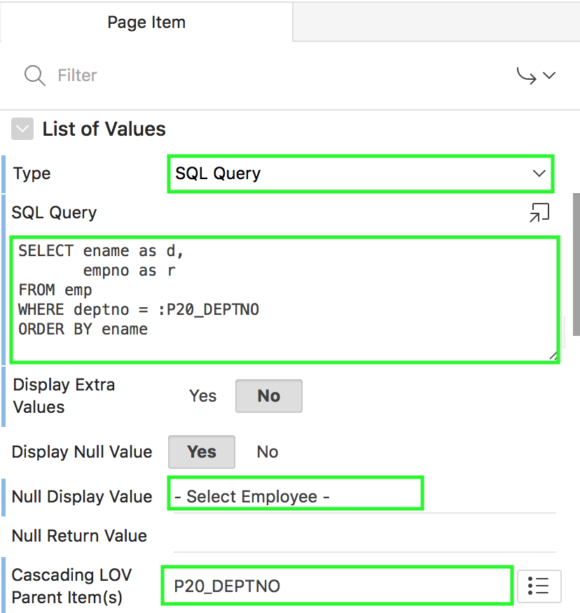
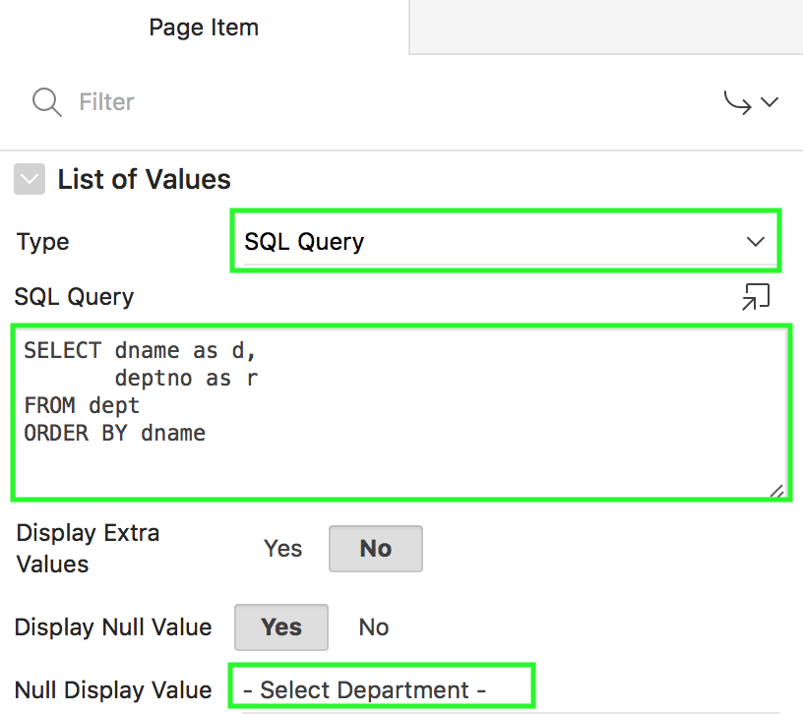
Creating a Cascading LOV: Steps
2
1
Notes:
Perform the following steps:
View the page in page designer. Create the first item as a Select List. For example, in the slide, create P<n>_DEPTNO as a Select List and the List of Values includes a SQL Query.
Now, create the second item as a Select List. For example, in the slide, create P<n>_EMPNO as a Select List.
For List of Values > SQL Query, include the reference of the first item in the WHERE clause. For example, in the slide, include the reference as :P<n>_DEPTNO
Under Cascading LOV Parent Item(s), select the first item. For example, in the slide select P<n>_DEPTNO
Click Save.

Slide 21
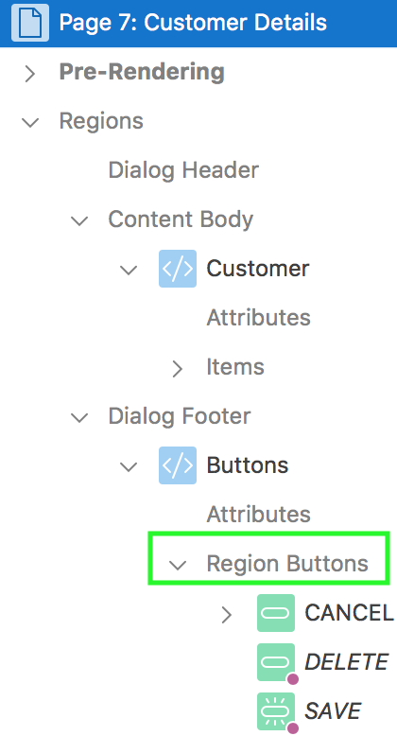
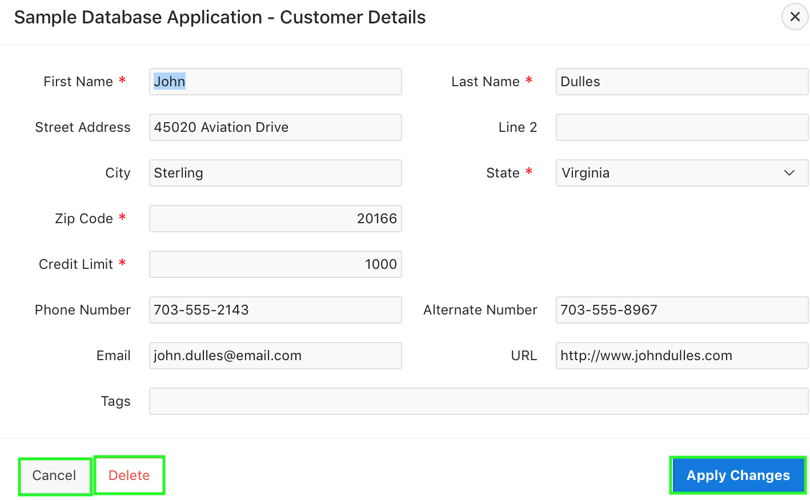
Creating Buttons
Region buttons
Region button
Notes:
As you design your application, you can use buttons to direct users to a specific page or URL, or to post or process information (for example, by
creating Create, Cancel, Next, Previous, or Delete buttons).
Buttons can perform different types of actions. A button can:
Submit a page (for example to save changes to a form page)
Redirect to either a different page or a custom URL
Do nothing (for example if the button's behavior is defined in a Dynamic Action).
When you create reports and forms using wizards, you notice that some buttons such as Cancel, Save, Create, and Delete are automatically
created.

Slide 22
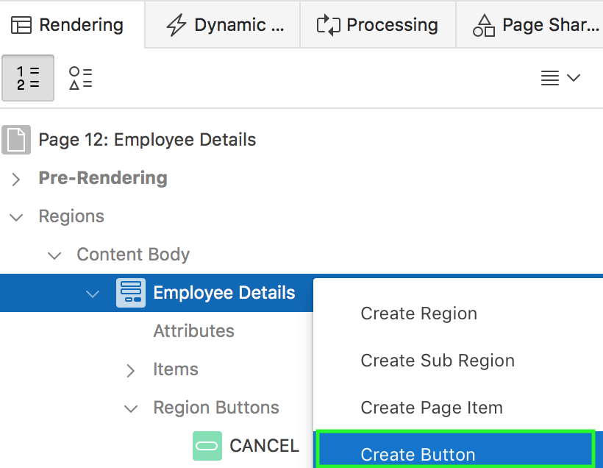
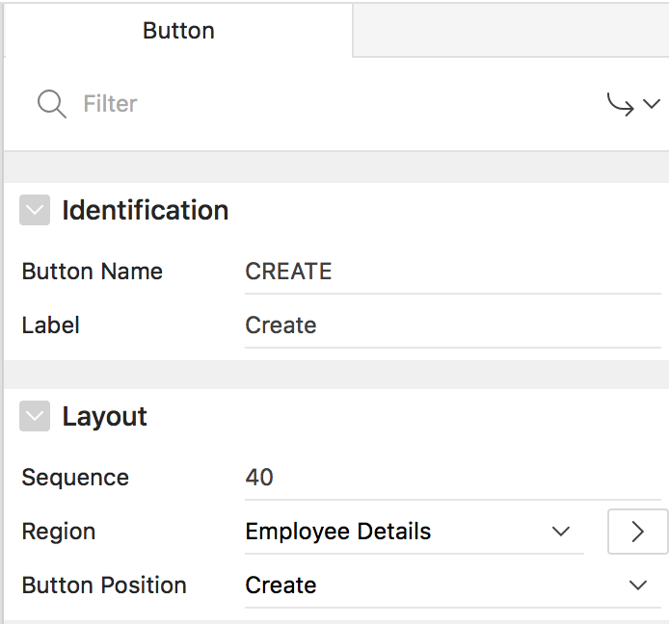
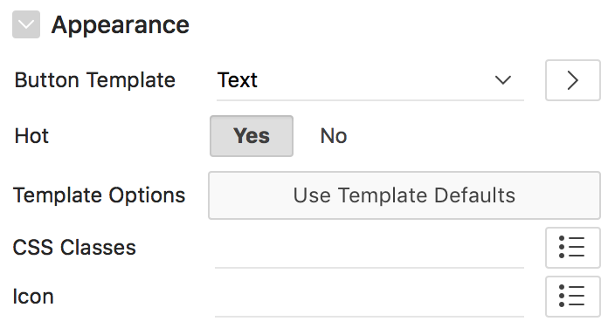
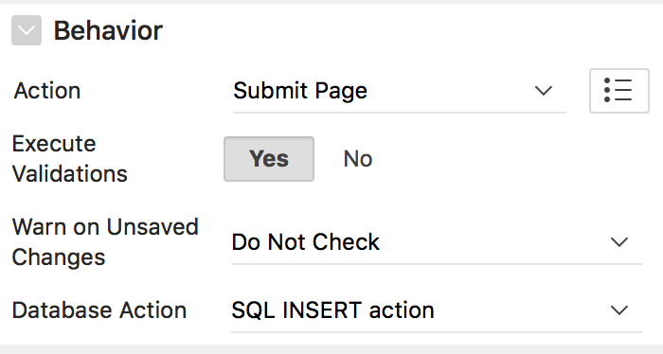
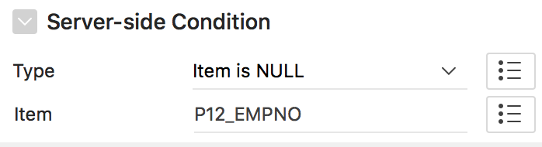
Creating a Button: Steps
2
3
1
4
5
Notes:
To create a new button, perform the following steps:
View the page to contain the item in Page Designer. If necessary, create a region to contain the item. Right-click the region and select Create Button. Alternatively, navigate to Gallery and click the Buttons tab. Right-click the button, select Add To, and select the appropriate location. You also select the button with the mouse and drag it to the appropriate location in the Layout tab. In the slide example, right-click the Employee Details region and select Create Button.
The Property Editor displays Button attributes. Edit the appropriate attributes.
Specify the button name and label
Under Layout >Button Position, select the position to display this button. The available template default positions identify the display position within the page template.
Under Appearance, select a button template to define the appearance of this button. Select whether to use the Normal or Hot button template when rendering this button.
Under Behavior, select the action to be performed when this button is clicked. Available options include:
Submit Page: Submit the current page with a REQUEST value equal to the Button Name.
Redirect to Page in this Application: Redirect to a page in the current application, with optional additional attributes for resetting pagination, setting the request value, clearing cache and setting item values, on the target page.
Redirect to Page in a different Application: Redirect to a page in a different application, with optional additional attributes for resetting pagination, setting the request value, clearing cache and setting item values, on the target page.
Redirect to URL: Redirect to the target URL you specify.
Defined by Dynamic Action: Does not submit the page or redirect to another page. Instead the button's behavior is defined by a Dynamic Action.
Specify the server-side conditions if any and click Save. In the slide example, you select Item is NULL for Type and select P<n>_EMPNO for Item.
After you create a button, you can edit its attributes. To edit the attributes of a button, select the button in the Rendering pane of the Page Designer. You see that the Property Editor shows the attributes of the button. You can then edit the button attributes and save the changes.

Slide 23
Summary
In this lesson, you learned how to create different types of page controls. You learned to create:
Items
Buttons

Slide 24


Slide 25
Hands-on Lab

